Slide 1
Introduction and OO Review
IN710 Object Oriented Systems Development
Semester 1, 2017
Session 1.1
Notes:
Little speech about 3rd year papers….

Slide 2
Course Philosophy
This is not a programming paper
Course outcomes:
Gain advanced C# skills
Improve the quality of your OO architectures
Learn to use industry standard techniques for the design and implementation of OO systems
Notes:
This is not a programming paper. I am assuming that you already know how to program. If not, this is not the right place for you.
Goals
Strengthen your C# and the .NET technique
Learn to build better OO software using a variety of processes and tools (items 2 & 3 above)
The emphasis will be as follows (although there will be some overlapping)
OO Development principles in lectures
C# details in prac tasks

Slide 3
Course Content
Primary design methodologies
Design Patterns (architecture)
Development Testing (unit testing)
Useful readings
Design Patterns: Elements of Reusable Object-Oriented Software. Erich Gamma, Richard Helm, Ralph Johnson, and John Vlissides. Addison-Wesley, Boston, MA, (January 1995)
Head First Object-Oriented Analysis and Design, Brett D. McLaughlin, Gary Pollice, Dave West, O’Reilly (2006).
The Art of Unit Testing : with examples in C#, Ray Osherove, Manning (2013)
Any good quality C# textbook/language reference (see the Safari collection)
Required readings provided
Extensive practical exercises
Two large projects
Notes:
Theory and practice
Readings are important and required. A lot of what we will be talking about in here is bulky and some of it is hard (but very little is boring…). You’ll need to do the readings to really understand it all.
Required readings and practical instructions are provided
Then toward the end of the paper, we will bring the two threads together in building a large-ish project which we will design using OOAD methodologies, and build in C#.

Slide 4
Schedule (Provisional)
Week | Session 1 | Session 2
1 | Introduction Remembering C# | Bridge Dealer
2 | Object Oriented Design Principles | New C#/.NET Features
3 | Development Testing (Unit Testing) Theory | Unit Testing Exercise
4 | First Design Pattern - Strategy | Game Character Class
5 | Decoupling Object Creation – Factory Pattern | Animal World
6 | Publish & Subscribe - Observer Pattern | Weather Station
7 | Advanced C# 1 – Delegates | Assorted Delegates
8 | Advanced C# 2 – Anonymous and Lambda | Assorted Anonymous & Lambda
9 | Advanced C# 3 – Multithreading | Assorted Multithreading
10 | Data Management – XML | Pubs & Clubs
11 | Data Management – Working with a DBMS | Art Museum Database
12 | Project Spec | Project Work
13 | Project Work | Project Work
14 | Project Work | Project Work
15 | Project Work | Project Work (Project due Friday this week)
16 | Exam Preparation | Exam
Notes:
The specific dates will change because of the need to add some topics not covered in IN613 last semester.
But it does show the correct content
Full course directive available on the I: drive
We will generally start session 1 each week with theory, discussion and the presentation of new material.
Then there will be coding through session 2
There are pass/fail checkpoints
There’s a big project that you will work on during the last four weeks, although there will also be work in practicals during that time.
The theory exam will be during the final scheduled class session.

Slide 5
Assessments
Assessment | Weighting
Practical Exercises | 25%
Projects | 45%
Exam | 30%
Please note:
Partial credit given, as appropriate, for practicals handed in on time.
Late practicals will not be accepted.
Zero marks are given for late practicals.
Notes:
There is no bending on the on-time practicals rule (except serious illness, family crises, etc.) The reason is that we have seen that, in this paper, those who fall behind don’t catch up. If you can’t get the practicals in on time (at least most of the way done), you’re not going to enjoy the paper, and should probably look elsewhere.
Practical due dates are specified on the specs, but generally will be either Friday to Wednesday or Wednesday to Wednesday, once we get to the real stuff.

Slide 6
Guiding Principle for Real Programming
“Now that my code is written and running, what happens if the specs change?”
If this is a crisis, your code was bad.
Coding to good OO principles helps to produce robust, flexible code.
Notes:
Once you get past the “how to write a for loop” stage, you need to think about how code actually works in the wild
In total, a lot less time is spent on the building than on the maintaining. And maintaining means “changing”.
If you doubt the importance of this question, try to recall the “Y2K bug” panic….
We will always be focussing on this question of extensibility and/or scalability. We will see it in practicals, where we will code to an original spec and then see what happens if we try to add or change functionality, so you want to be always aware of it.

Slide 7
Core OO Principles Review
Abstraction
Encapsulation
Association
Inheritance
Polymorphism
Notes:
If you weren’t coding pre-OO, it’s a little hard to get a handle on why it is such a big deal.
But the move to OO was a qualitative change in the way things had always been done. There was extensive debate on whether it was, in fact, the best protocol for expressing algorithmic solutions to problems
If you have always ‘done classes’ you may have lost sight of these important things. (Next time we will look at some more detailed, complicated and advanced design theory/principles; these are the basic ones that you should already know.)
If you don’t keep an eye on them, you may be doing classes, but you’re not doing good OO
OO is, at the moment, fairly ubiquitous (although interestingly, some non-OO things are creeping in to VS – discuss later), so you need to know it.
Pay careful attention to this part btw, because it is a favourite for interview questions….

Slide 8
Core OO Principles Review
“Remember, learning concepts like abstraction, inheritance and polymorphism do not make you a good object oriented designer. [The true goal is to] create flexible designs that are maintainable and can cope with change”
H-F DP, pg xi
Notes:
Just in case you had forgotten…….

Slide 9
Abstraction
A higher-order description of something that eliminates lower-order details.
A model of a computational entity in terms of its interface, not its implementation.
Notes:
Abstraction is the true core difference between OO and SP.
We talk in abstractions all the time. When we talk about “the degree” instead of listing all the papers you have to take, that is an abstraction.
Abstraction in programming refers specifically to providing a view of an entity that can be used (by programmers) without their having to get tangled up in the details.
When we work with objects we call their methods, we don’t need to know the code in those methods.
We work with an abstraction (the method name – what the thing does) rather than the detail (the code – how it does it).
Terminologically, we separate the interface (abstraction) from the implementation (concrete).
In OO design we start by ‘imagining’ the things that are happening in our computational universe as individual entities.
It’s a giant exercise in anthropomorphism.
(If you have always programmed this way, it will be hard to imagine how weird it was at first. To get a glimpse, try to think of the ‘objects’ in a maths’ library….)
The great benefit of abstraction is that it allows you to think about the problem being solved without getting hung up on a lot of details. (Like the frictionless plane and weightless elephant in physics…)
Each time we think of a program as a set of interacting objects, we are abstracting.
Abstraction is used to manage complexity. We can abstract away the implementation details while working out how the system should behave.

Slide 10
Abstraction
Examples
int
Subroutines
Classes
Notes:
As it turns out, abstraction has been around a lot longer than OO.
As soon as people started dealing with data types (instead of binary strings) we had abstraction.
Having ‘int’ lets us concentrate on solving a problem using ‘integer things’
Underneath, we know that there are 0s and 1s and somebody is dealing with all that, but we abstract away that complexity and just think about ‘int’
All subroutines are also abstractions of the behaviour they implement. When coding, we just call the method and don’t worry about what it going to happen.
See how this simplifies the thinking?
Classes extend this by collecting methods and data and surrounding them with an abstraction (their method prototypes).
We can use the functionality of the class without having to get tangled up in the implementation details.

Slide 11
Encapsulation
Abstractions in OO should be ‘encapsulated’
Only the interface of an abstraction is visible. The implementation is hidden (encapsulated).
Encapsulated data is protected from access by other entities
Proper encapsulation promotes robustness and flexibility.
Notes:
Encapsulation was a big deal in language design.
Basically, any OO language must provide a facility for encapsulating object abstractions, breaking them into a visible interface and a hidden implementation
In modern OO languages, this is, of course, the class construct.
This enables us to bundle up data and operations on that data in a black box
Do you see why it promotes robustness and flexibility? => Protection from damage due to change

Slide 12
Association
The interaction of objects from different classes
Types
Composition
Aggregation
Inheritance
Notes:
Two classes that interact are said to have an association
Without association, everything would be abstracted and encapsulated and nothing would actually happen….
There are various types of association.
Composition and aggregation are ‘has-a’
Inheritance is ‘is-a’
We will treat inheritance separately

Slide 13
Composition and Aggregation
Unfortunately, there is some disagreement about these terms
Notes:
In fact, depending on what source you read, you can get completely orthogonal definitions
Don’t worry about that, just make sure that you understand the two types of situations where you would combine classes in these ways

Slide 14
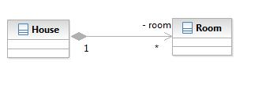
Composition and Aggregation
Composition:
Object B is part of object A
If object A is destroyed, object B is no longer logically defined
Image: www.javadesign.info
Notes:
In fact, depending on what source you read, you can get completely orthogonal definitions
Don’t worry about that, just make sure that you understand the two types of situations where you would combine classes in these ways
BTW, this is a UML class diagram. We will be looking at UML diagrams in more detail later, but the class diagrams are pretty self-explanatory
The diamond here means ‘composition’. The 1 and * indicate one-to-many just like in an ERD
We see this when we have classes that have pointers to/instances of other classes in their class data properties. For example, in ADS we had a TMaze that was composed of TCells

Slide 15

Composition and Aggregation
Aggregation
Object A has an Object B
If object A is destroyed, object B may still exist
Image: www.javadesign.info
Notes:
The hollow diamond here means ‘aggregation’. The 1 and * indicate one-to-many just like in an ERD
We aggregate all the time, when for example we pass a listBox into a class for displaying.
When the class is destroyed, the listBox is still there no problem.

Slide 16

Aggregation or Composition?
Car
Engine
Notes:
Just so you don’t become confused in your wide reading, note that in academic circles you can get some pretty detail-oriented (i.e. stupid) arguments going here.
Does a car ‘have an engine’, or is a car ‘composed of an engine (and other things, of course)
Since a car won’t run without an engine, some people would say the car is composed of the engine. If the car ceased to exist, the engine has no logical meaning
Others would argue that, since you could remove the engine and put in another car, it must be aggregation because the engine exists on its own
Mostly, this is pure self-indulgence and totally unimportant.
What you should understand is that, when thinking about cars, the engine stuff is logically distinct. So we want to ABSTRACT the engine part and ENCAPSULATE it in its own class. We then make up our car by ASSOCIATING it with an engine
To avoid brain strain, people often just say ‘composition’ and don’t worry about it.

Slide 17
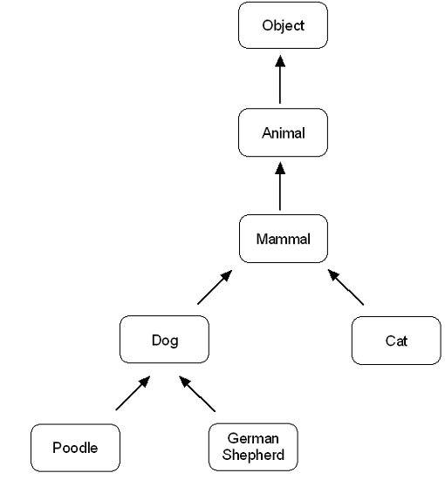
Inheritance
The ‘is-a’ association
Class B is a specialised kind of Class A
Image: www.sydig.com
Notes:
Here’s the traditional example

Slide 18
Inheritance
Children inherit the data and methods of their parents
We encapsulate common functionality in the parent
The children extend and/or modify that functionality
Notes:
“functionality” refers to data and methods in combination

Slide 19
Inheritance
Two reasons to inherit:
You need a class that requires all the functionality of an existing class plus something more.
There is some common functionality that is implemented differently in different circumstances.

Slide 20
Inheritance Case 1
Children inherit the data and methods of their parents
We encapsulate common functionality in the parent
We implement additional functionality in the child
The child ‘extends’ the parent
The child has data and/or methods that the parent does not have.

Slide 21
Inheritance Case 2
Children inherit the data and methods of their parents
We encapsulate common functionality in the parent
We descend multiple children.
Each child implements some functionality in its own way.
Children do not necessarily provide any data or methods that the parent does not also provide.
Notes:
They can do so, but they may not (i.e. all virtual methods).

Slide 22
Inheritance
A class family may exhibit both kinds of inheritance.

Slide 23
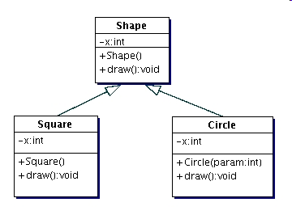
Polymorphism
The ability of a child to redefine the precise implementation of a common method
Permits late binding
Image: www.digisolutions.com
Notes:
The formal term for what you get in Inheritance 2

Slide 24
Inheritance
Advantages
Abstraction
Code reuse
Localised modification (reduced redundancy)
Subclasses are more succinct
Natural mapping in some contexts
Notes:
Write it once, use it over and over.
Saves time and eliminates the many possibilities for errors that would be introduced by writing it again and again
Modification occurs only in one place

Slide 25
Inheritance
Disadvantages
Chained inherited calls can damage performance
Can lead to large and cumbersome class hierarchies
Parent functionality can be hard to find
Changes in upper levels of the hierarchy can have unexpected consequences on the children (tight coupling)
Notes:
Inheritance is powerful and fun to do, but not always a good idea.
And the bad things about inheritance are more bad than the good things are good, if you’re not careful.
Keep in mind that inheritance automatically introduces tight coupling (Coupling: changes in one class affect instances of the other class)
We will discuss the problems of tight coupling more as we go, as it is a bad thing if you want your code to be flexible.
These are some problems…

Slide 26
Inheritance
Misuse of inheritance
Be careful not to inherit when the child ‘is-a’ relationship does not actually exist
This introduces tight coupling between the classes without the benefits of a true inheritance relationship.
Notes:
Coupling: changes in one class affect instances of the other class
We will discuss the problems of tight coupling more as we go

Slide 27
Inheritance
Not is-a
Class A needs to use an object of Class B, but does not fill the same logical role that Class B fills
Class A needs part, but not all of the functionality of class B
A group of classes all need to provide a set of logically identical methods, but share no common functionality or data
Notes:
Example – making the Game of Life by descending from a dataGrid. Nuts. Just give the GameOfLife class a dataGrid
False generalisation
you can end up with child classes that have methods that actually make no sense for them
What to do when class A needs part but not all of the behaviour or class B? -> Give A an instance of B (composition)
Interface inheritance
For example, both stacks and queues need to provide ‘push’ and ‘pop’, but they implement them polymorphically. They share no common methods, so what base class are they from?
We will see what works here next week (Interface/abstract inheritance)
We will also discuss a design principle that helps you to identify when inheritance is appropriate

Slide 28
Inheritance
“Favor object composition over class inheritance “
Gamma, et. al., Design Patterns
Notes:
In addition to/another consequence of the looser coupling of composition, note that inheritance is static at compile time (i.e. the parent class, and hence the shared functionality, is set in the code) but composition is set at run time (i.e. the object passed in for composition can be deferred until runtime, e.g. using a conditional to decide what object to pass into the constructor

Slide 29
Required Reading
Martin, Robert C. (2008) Clean Code, Prentice-Hall.
Chapter 1
Available online in the Safari collection (from any OP machine, or via the ViewClient)
http://proquestcombo.safaribooksonline.com
Notes:
All required reading is required
We will frequently discuss readings in the class, and the material they contain will appear on marked practicals
Note that only 5 people can access any Safari book simultaneously, so don’t leave it until the last minute and find yourself locked out.

Slide 30
In-Class Practical
Write a C# program that copies the contents of a two-dimensional array into a one-dimensional array.
A | C | E | G
B | D | F | H
A | B | C | D | E | F | G | H
Notes:
Because there is some variability in what you might have learned already, I need a chance to watch you code.
That happens now.

Slide 31
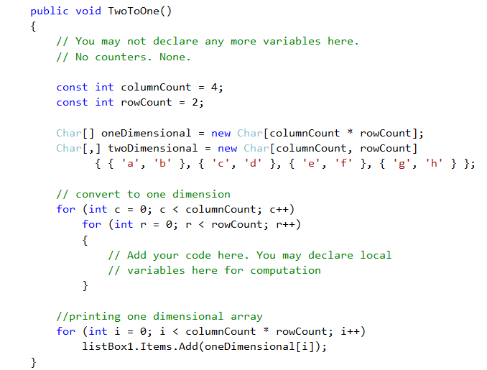
In-Class Practical
Notes:
You must start with this (text file available on I:drive, or type it in)
Write this method and call it in a button click handler on the form.
NB: You may only declare new variables local to the nested for. You may not declare any kind of counter.
We will spend exactly 20 minutes on this – if you don’t finish it in that time, then you’ll just stop. I will walk around and see how things are going.
No discussion, please. This is an individual exercise.

Slide 32
Task 1 – Class Design
Before next session (mandatory)
Bridge Dealing Application:
A bridge deal comprises four hands (N,S,E,W), each made up of 13 cards
The quality of a bridge hand is measured by counting its High Card Points
A = 4
K = 3
Q = 2
J = 1

Slide 33
Task 1 – Class Design
Design a class architecture for a Bridge Dealing program that deals out four hands and displays them (textually), sorted into suits, along with the HCP for each hand.
Draw a UML-style diagram of your classes, showing class name, properties and methods for all classes.
Pseudo-code your methods.
Bring your class diagram and pseudo-code (hard copy; hand-written is fine) to class for Session 2
Notes:
Don’t implement, just write the documents. This practical is marked on the documents.
Think especially carefully about the core OO principles while designing your classes.
Look especially for coupling – does any class know more about the implementation details of any other class than is absolutely necessary?

